Slide 1
How do you fit a Core Banking system into a few containers?
Amine Boudali Nordea, Delivery Lead of CBP Platform Stream
Jose Quaresma Accenture, DevOps Lead Denmark
06.06.2017
#bankincontainer
Notes:
[Amine]

Slide 2


Amine Boudali Nordea
Delivery Lead of CBP platform stream

amine.boudali@nordea.com
Jose Quaresma
Accenture Denmark DevOps Lead
dPaaS platform owner in CBP

jose.quaresma@accenture.com
@josequaresma
Notes:
[Amine]

Slide 3
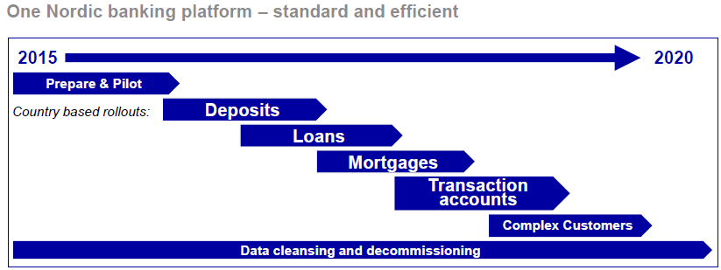
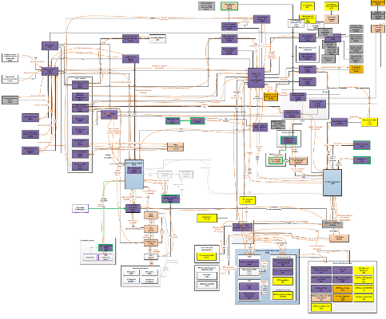


– Nordea – The largest financial services group in the Nordics
Core Banking Programme
~11 million customers
~10 million personal customers
700 000 corporate customers
Largest transformation programme in Banking in Europe at present
Focused on delivering incremental & frequent business value
Complex landscape
resulting from several mergers
Notes:
[Amine]
Remember:
CBP as a vehicle for organizational change and best practices in Nordea
Simplification and Consolidation of Core Banking Systems in Denmark, Sweden, Norway and Finland

Slide 4
Where we started
Our guiding principles
Automation
Env. Provisioning
Test automation
CI/CD
Everything as code
Env. Configuration
Delivery pipeline
Short Feedback Loops
For developers & testers Fail fast
Learn Quick
On our way to CI/CD
Continuous Integration
Automatic build & deployment to Dev/Test
Configuration management
Custom-made solution
Not quite everything as code
Daily build & deploy
Lengthy build
No live deployment
Our situation B.C.
Notes:
[Jose]

Slide 5
Pain Points
Easing the Pain
Long Environment Provisioning time
Environment Provisioning time from weeks to 1 hour
High Number of short-lived environments
Less cost for provisioning/deleting environments
Better Environment Lifecycle management
Complex deployment orchestration / Requires downtime
Simpler deployment
Deploying only one container / Live deployment
Fragmented environment configuration
No full control of all components
Infrastructure as code
How to integrate so many development and test environments?
Service Virtualization
Need to shorten feedback time to developers and testers
More frequent deployments to Development environments Time Travel in test environments
Notes:
[Amine]
High Number of short Lived environment: Infrastructure not agile enough to keep up with the provisioning & decommission rates

Slide 6


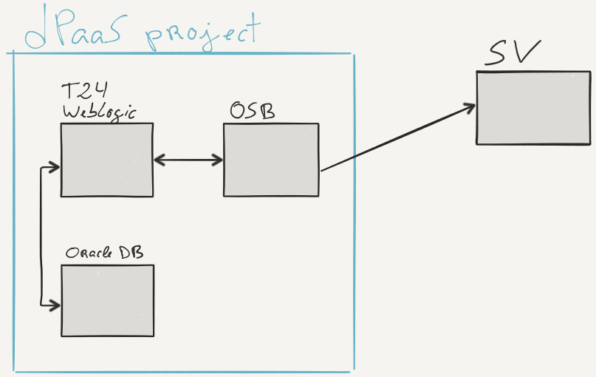
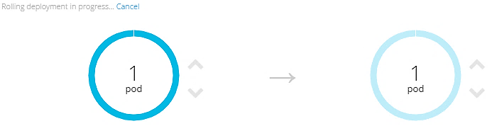
Our Answer
6 Months
5 People
Notes:
[Jose]

Slide 7


New challenges!
No Thanks!
We are too busy
Getting people to use the platform
– Lack of awareness –
Heavy containers: WebLogic, Oracle Database Slow to load and to rollback
Big paradigm shift: From servers as pets to servers as cattle
Much more focus on infrastructure as code
No more visits to the vet!
Notes:
[Jose]
Provides us full control over database (as opposed to the traditional one)

Slide 8


Something to think about
Management of Expectations
When is your new platform/tool ready to be released?
People
How to balance?
People, Processes, and Tools
Process
Tools
Exploring/Experimenting with new solutions / tools / platforms
Notes:
[Amine]

Slide 9
Thank you!
Amine Boudali Nordea
Delivery Lead of CBP platform stream

amine.boudali@nordea.com
Jose Quaresma
Accenture Denmark DevOps Lead
dPaaS platform owner in CBP

jose.quaresma@accenture.com
@josequaresma
Notes:
[Amine]

